Slide 1

COMPUTER NETWORKS
Dr. S. Sathya Priya,
Associate Professor,
School of Computing Sciences.

Slide 2

Error detection and correction
Types of Errors:
When bits flow from one point to another they are subject to unpredictable changes because of interfernce.
Single bit error:
Only 1 bit of a given data unit is changed from 1to 0 or from 0 to 1.

Slide 3
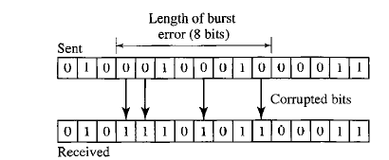
Burst Error:
2 or more bits in the data have changed from 1 to 0 or from 0 to 1.
Burst error need not necessarily
mean that errors occur in consecutive
bits.
Length of burst is measured from first corrupted bit to the last corrupted bit.
Bits in between may not have been corrupted.

Slide 4
REDUNDANCY:
Central concept in detecting or correcting errors.

Slide 5
Flow control and error control
Responsibilities of Data Link Layer: Flow Control and Error Control-Data Link Control.
Flow Control: Set of procedures to restrict the amount of data that the sender can send before waiting for acknowledgement.
Error Control: Both error detection and correction
In Data link layer, error control-methods of error detection and retransmission(Process called Automatic Repeat Request-ARQ)

Slide 6
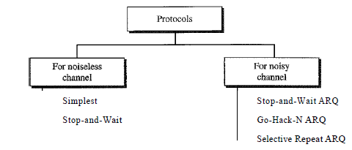
protocols

Slide 7
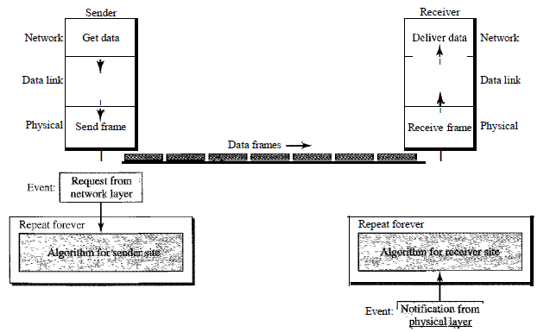
simplest

Slide 8
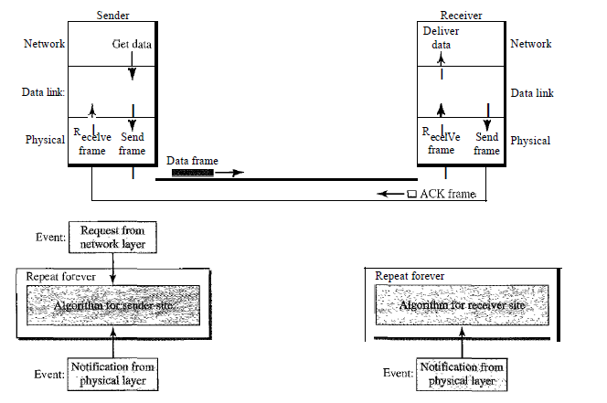
Stop and wait

Slide 9
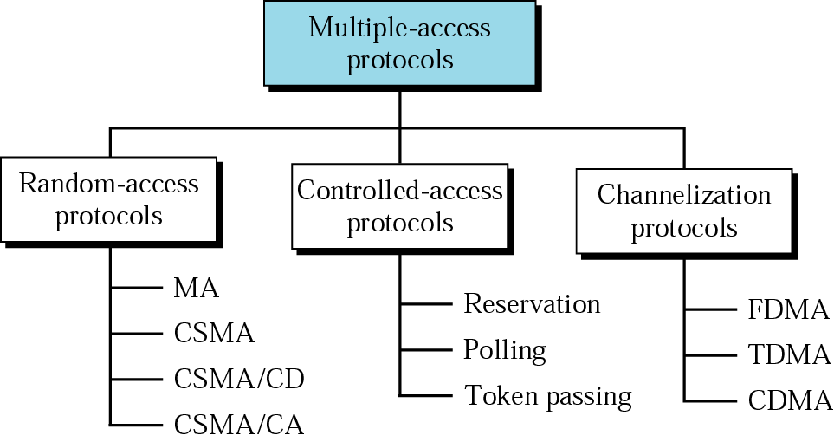
Medium access control

Slide 10
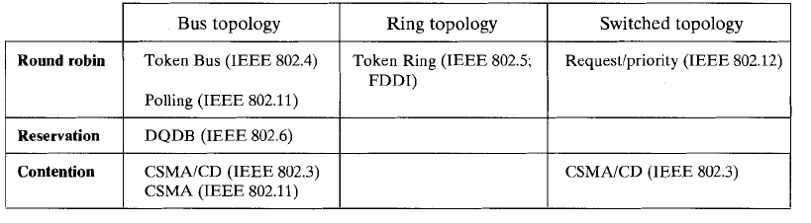

Slide 11
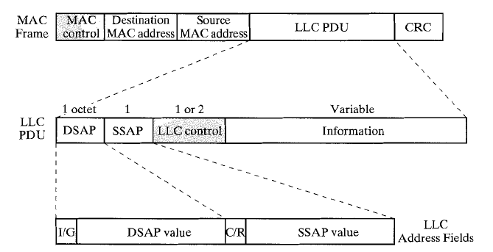
Mac frame format

